Slide 1
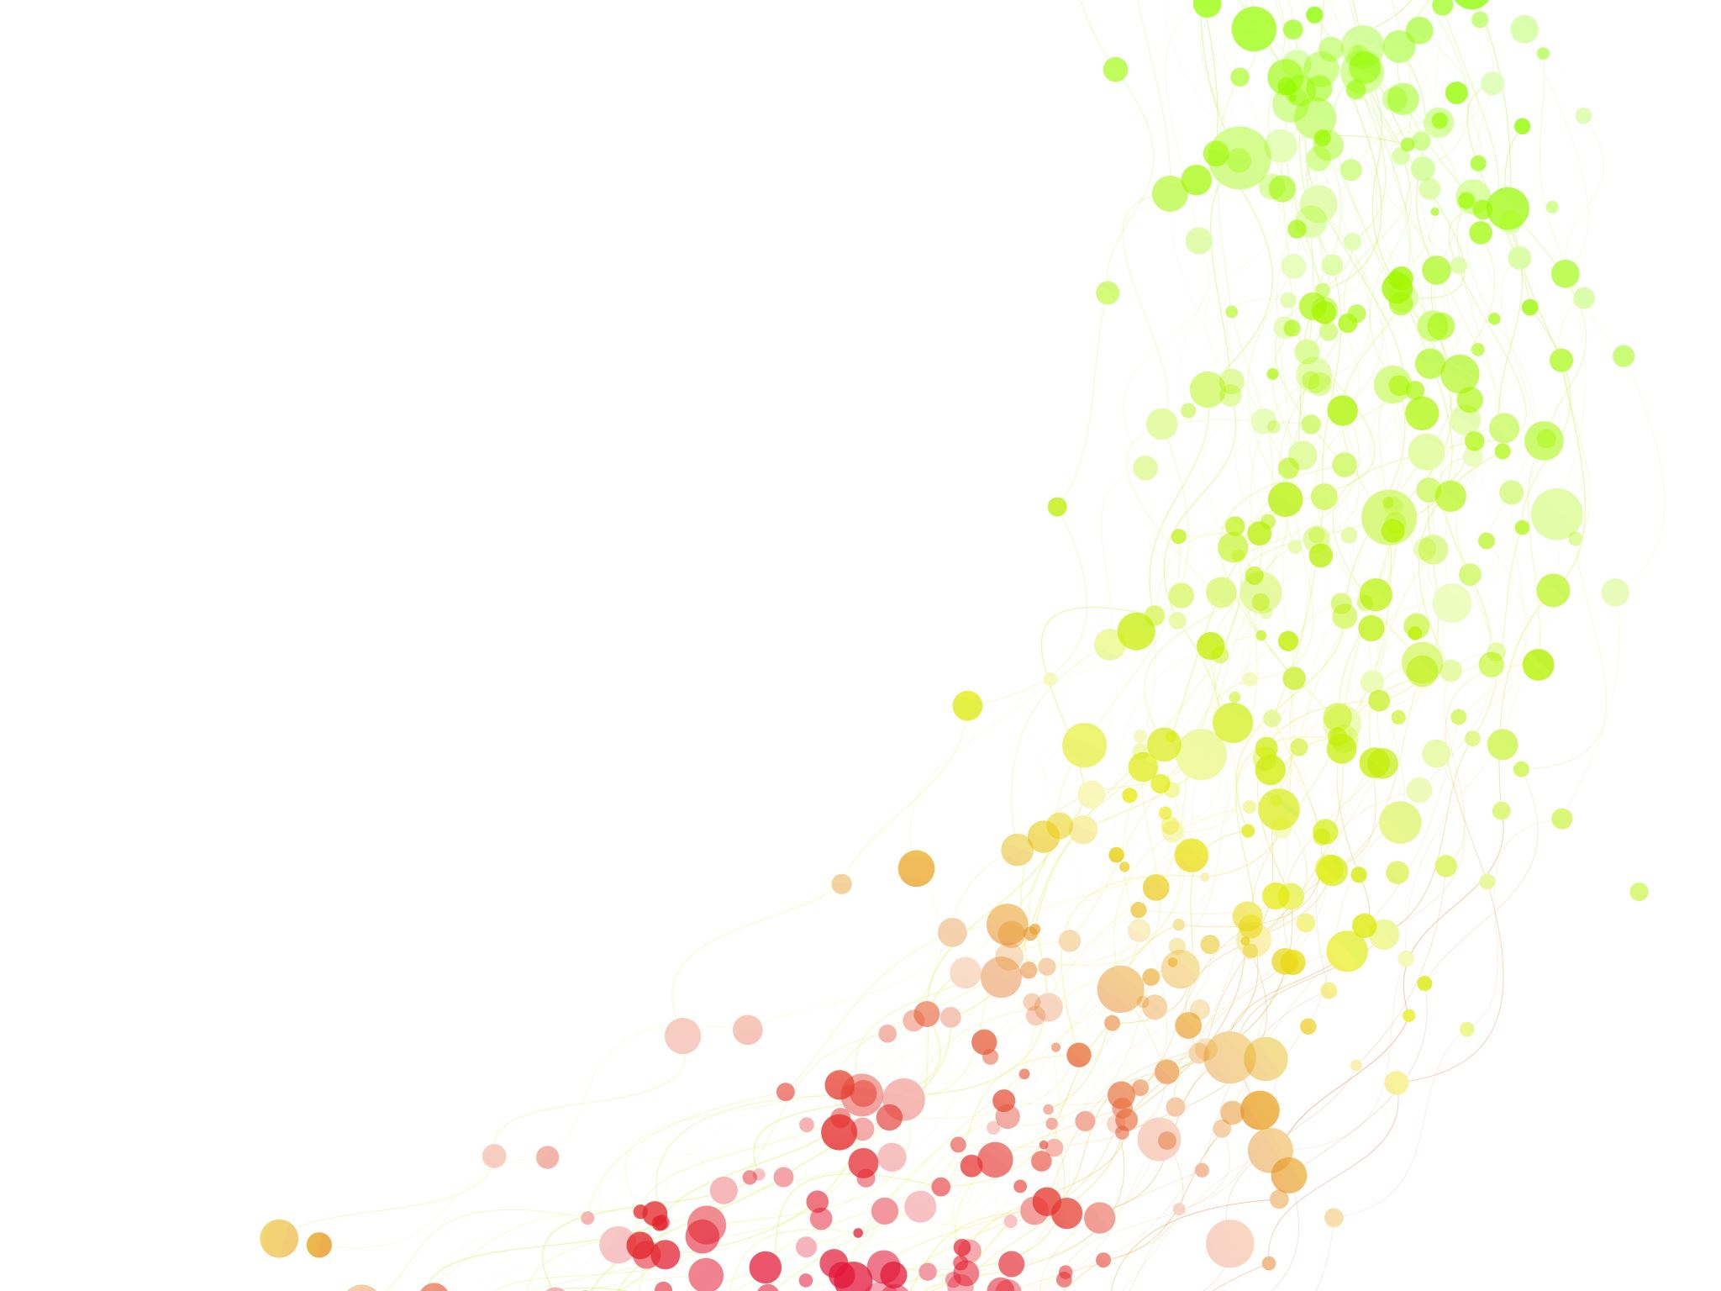
Diabetes
Predictive Analytics
DSC 630
Abed Tabbalat
Notes:
Hello everyone. My name is Abed Tabbalat and I have decided to do my project based on a diabetes data set. Usually, I follow the homeowner’s insurance industry and that is an area I'm very familiar with. However, for this specific project, I have decided to go into an unfamiliar area and expand my knowledge in diabetes. The reason I chose this topic is I had a direct correlation to diabetes were someone from my family got diagnosed with it. I had no idea how diabetes works, so with all the research that I have done, I have become much more familiar with this topic.

Slide 2
Overview
Libraries
Data
Exploratory Data Analysis
Model Application
Results
Notes:
Now going over the overview. In this project we will go over the libraries, the data, we Will do some exploratory data analysis, model application and then finally we'll go over the results.

Slide 3

Libraries
Notes:
Starting with the libraries. I had to go through many libraries to test and some of them worked, but others just led me to different directions than what I needed.

Slide 4
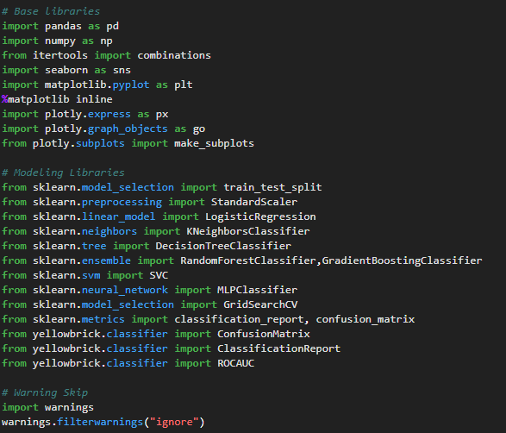
Libraries
Pandas & Numpy
Seaborn & Matplotlib
Sklearn & Yellowbrick
Warnings
Notes:
The main libraries that were used are pandas and Numpy. Those are always standard In data science and they are used heavily with data sets.
Seabourn and Matplotlib are used for data visualisation and were heavily used with this model specifically, the EDA that has been done, charts and graphs.
SKlearn and yellow brick were used for the modelling and accuracy determination.
and the warnings are simply to make the code look cleaner.

Slide 5
Data
Notes:
Now we'll go over the data. Including what variables the data consists of, The type of data that had to be dealt with, and what obstacles that were observed that requires some modifications to make the data applicable for modelling.

Slide 6
Data – Variables
1. Pregnancies: Amount of time the patient been pregnant
2. Glucose: Patient glucose levels
3. BloodPressure: Patient blood pressure
4. SkinThickness: Patient skin thickness
5. Insulin: Patient insulin level
6. BMI: Patient Body Mass Index
7. DiabetesPedigreeFunction: Indicates the function which scores the likelihood of diabetes based on family history
8. Age: Patient age
9. Outcome: 1 for positive diabetes, 0 negative diabetes
Notes:
The data set contains 9 variables.
Pregnancies: counts the amount of time the patient had been pregnant.
Glucose: the patient, glucose levels. Blood pressure. Skin thickness. Insulin. body mass index.
diabetes pedigree function indicates the function which scores the likelihood of Diabetes based on family history.
age and then the outcome which decides one would be positive for diabetes and zero would be negative for diabetes

Slide 7
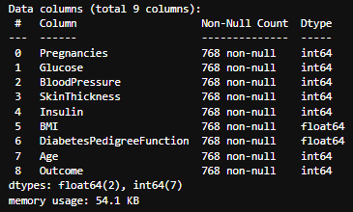
Data – Type
Initial observation
All variables are numeric with the exception of Outcome.
Logistic regression was the first choice to go with modeling.
Notes:
First part is the data and the type of data. The data type varies between an integer and a float. An integer consists of whole numbers. And a float includes decimals.
Based on what the variables mean, we can observe that the data is numeric except for outcome is binary as mentioned.
Therefore, just by looking at the types of data, logistic regression came to mind as the type of model to use.
But assessing what model series will come later as we will be testing the outcomes of logistic regression, random forests and decision tree.

Slide 8
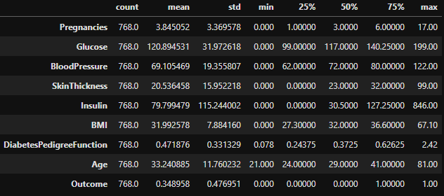
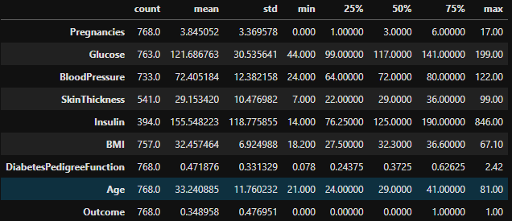
Data – Cleaning
Before fix
Problem: Some min values needs to be checked as it is impossible to have a value of 0
Solution: Values with 0 have been replaced with Nan
After fix
Notes:
Cleaning the data. Once looking at the data description, if we look at the minimum column, we can see a bunch of zeros as a minimum value in glucose, blood pressure, skin thickness, insulin and BMI which is impossible for a living human being to have and therefore it is considered as incomplete data.
After analysing, it was determined that the best way to handle this is by converting the zeros those variables to null to be able to go to the next step which is handling the null values.

Slide 9
Exploratory Data Analysis (EDA)
Notes:
EDA: Now we’ll go to is a bit heavy on analysis. We will start by handling the null values and determining what we can replace them with and we’ll check the outliers, and if there are any, what would be the best course of action to take in handling them once those two components have been taken care of. I did regular eda practises to understand the data better.

Slide 10
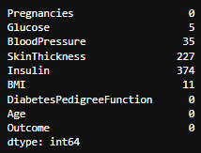
EDA – Addressing Nan Values
In order to address the Nan values, histograms needs to be applied on each variable to determine the replacements:
Notes:
addressing the null values
after replacing the zeros with null values, can see that five variables now contain the null values that need to be addressed as mentioned earlier, the best way it was handled by running histograms on these variables . The distribution of the histograms determines if we will use the mean or the median to replace the null values.

Slide 11
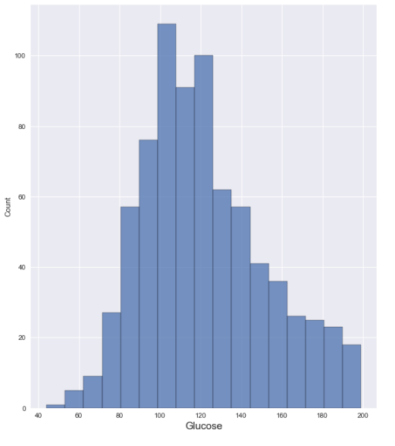
EDA – Addressing Nan Values (Continued)
Glucose
Skewed right
Replaced Nan with Median
Notes:
Going over glucose, we can see the chart is skewed to the right. so, we replaced it with median.

Slide 12
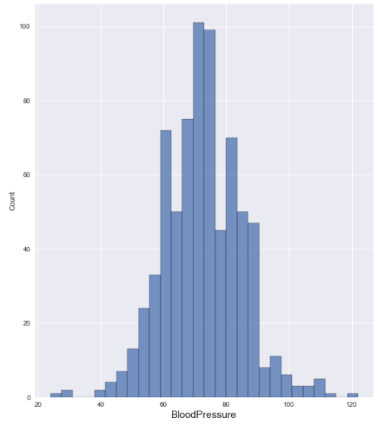
EDA – Addressing Nan Values (Continued)
BloodPressure
Normal
Replaced Nan with Median
Notes:
Blood pressure. Normal. This one could be argued that the histogram is slightly skewed to the left. However, just to keep things consistent, I went with normal distribution. And replaced the null values with median.

Slide 13
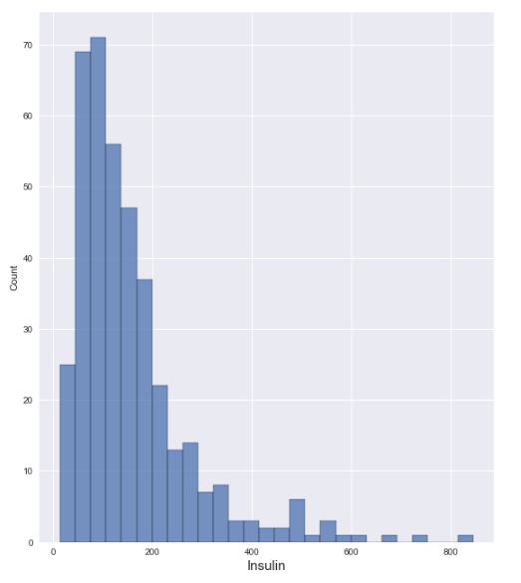
EDA – Addressing Nan Values (Continued)
Insulin
Skewed right
Replaced Nan with Median
Notes:
Insulin. Skewed to the right ,replaced with median.

Slide 14
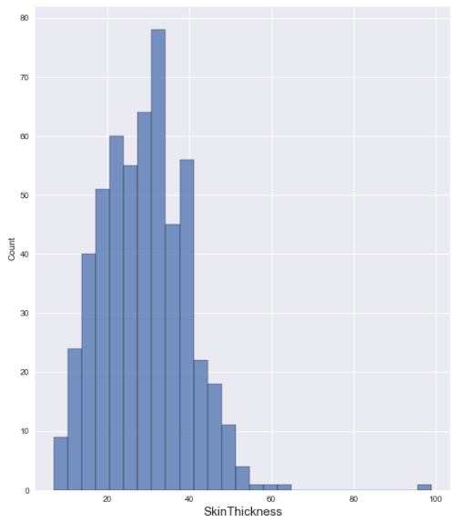
EDA – Addressing Nan Values (Continued)
SkinThickness
Skewed right
Replaced Nan with Median
Notes:
Skin thickness skewed to the right, replaced with a median.

Slide 15
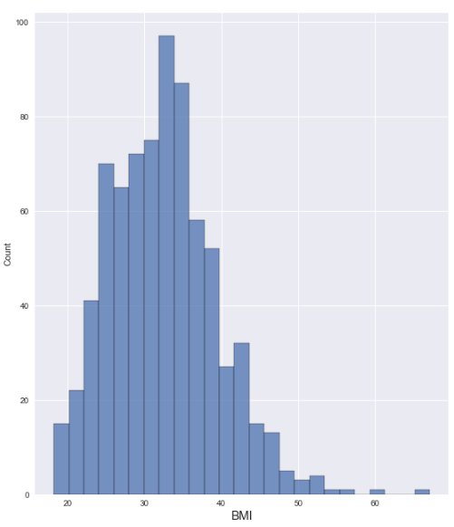
EDA – Addressing Nan Values (Continued)
BMI
Skewed right
Replaced Nan with Median
Notes:
BMI skewed to the right, replaced with median.

Slide 16
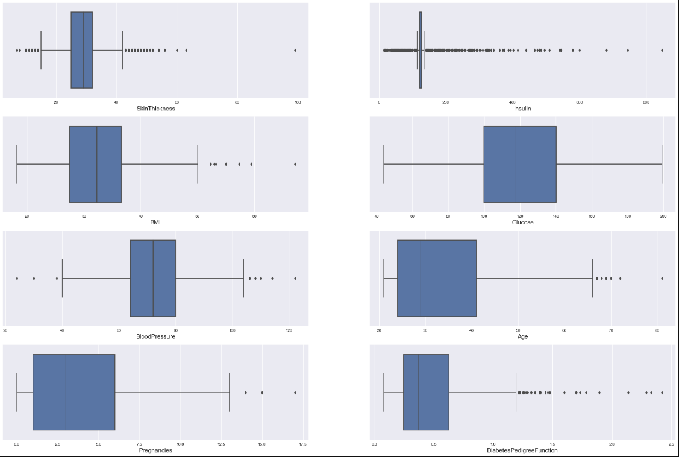
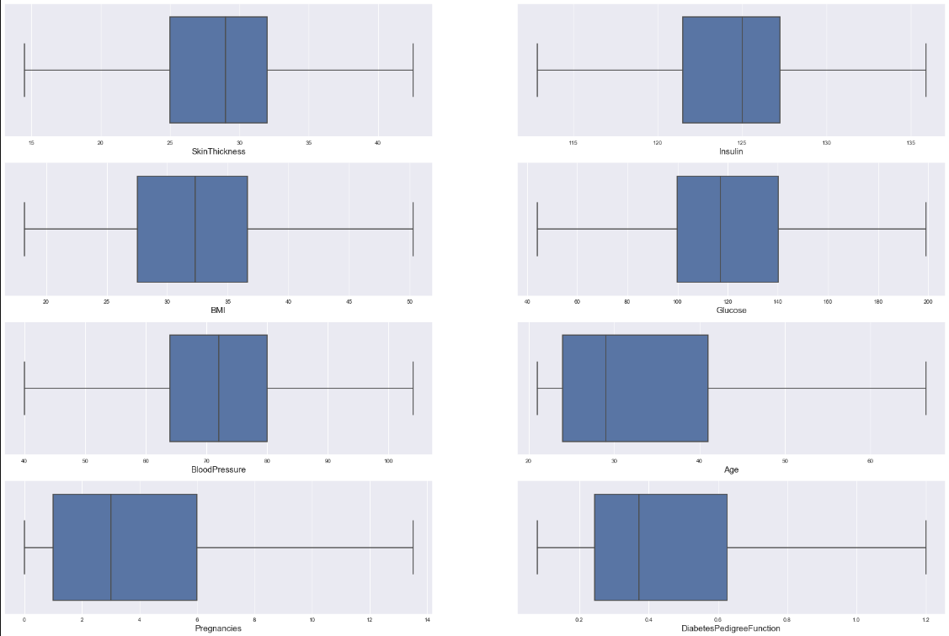
EDA – Addressing Outliers
Before
After
Notes:
outliers.
I ran box plots to determine if there are any outliers. As we can see, there were a bunch of them, especially for insulin. Handling outliers can always get complicated. The easiest way to handle outliers is to just exclude them from the data set that is going for the modelling. Since the data isn't large enough to do so, I went with using the quantile function. I had to research the quantile function online. And there was a bunch of videos that I found that run the quantum. As we can see, I ran the function successfully and we can see that that the outliers are gone.

Slide 17
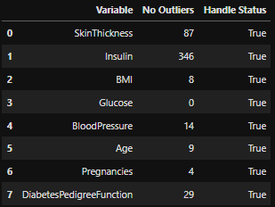
EDA – Addressing Outliers(Continued)
Quantile function applied
75% used for high fence
25% used for low fence
Notes:
Addressing Outliers (continued). The way the quantile function is used by determining an upper threshold and a lower threshold, the function was applied successfully and the table shows the success of the outliers being handled.

Slide 18
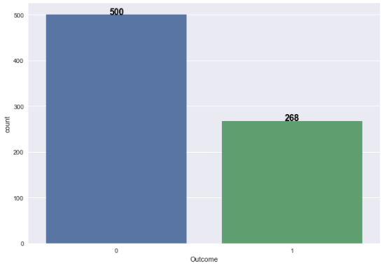
EDA – Outcome
35% Positive Outcome
65% Negative Outcome
Notes:
Now the data is ready to be analysed as it is, we can see that 65% of the patients within the data do not have diabetes and 35% of the of the patients do.
This would be considered the overall view of the data.
Since we're trying to predict the outcome, it is good to know what the current outcome is showing.

Slide 19
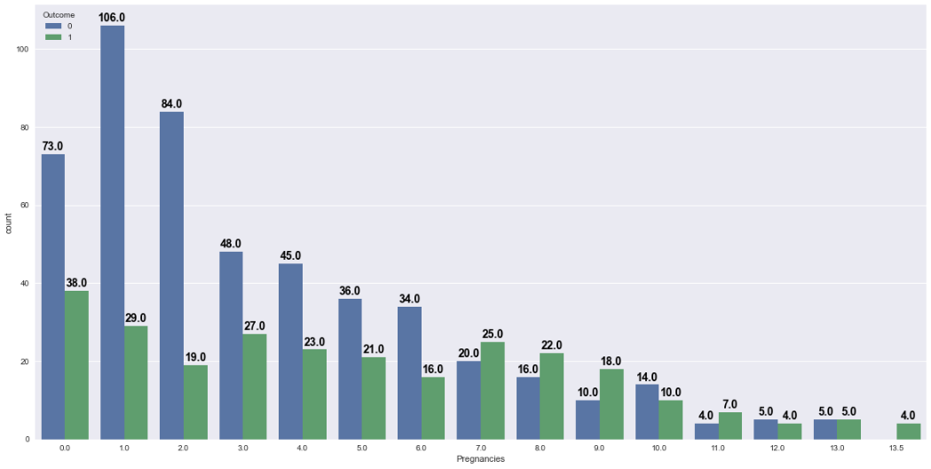
EDA – Pregnancies
Highest Positive Outcome Count: 0 Pregnancies 14.2% of positive outcome pool
Notes:
I wanted to focus on pregnancies.
As we can see in the chart on the left. A high positive outcome count of 0 pregnancies which is equivalent to 14.2% of the positive outcome pool.

Slide 20
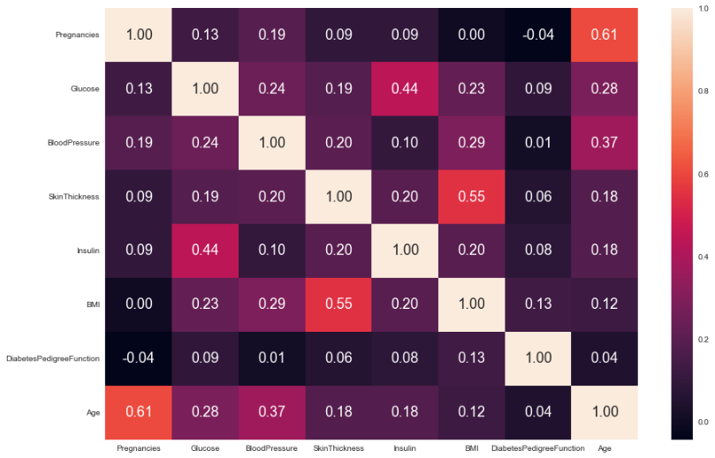
EDA – Correlation Matrix
Outcome is taken out of the correlation since it is binary
Highest Correlation:
Glucose & Insulin
Pregnancies & Age
SkinThickness & BMI
Notes:
This part gave me some challenges since the correlation matrix using spearmen’s correlation requires continuous data.
Since outcome is binary, I ended up excluding it from this exercise to be able to perform the correlation matrix on the continuous data in the data set.
The findings are glucose and insulin have a high correlation as expected, as well as pregnancy with age. The older the patient is, the more likely the frequency of pregnancy is.
Skin thickness and BMI as well, again as expected.
the reason for that is to do modelling and predicting outcome with a high correlated data and see how that impacts the accuracy of the model or if the model can be sufficient only on the high correlated data

Slide 21
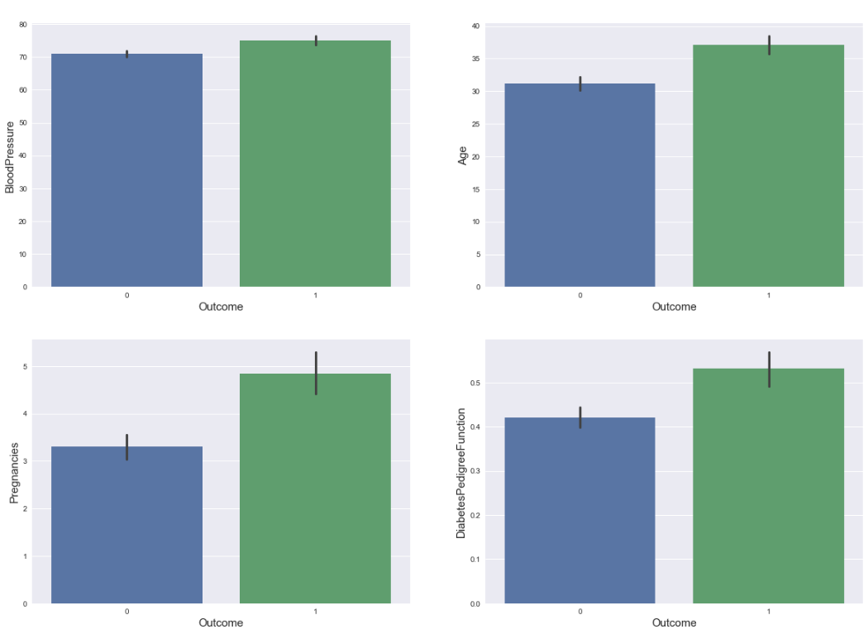
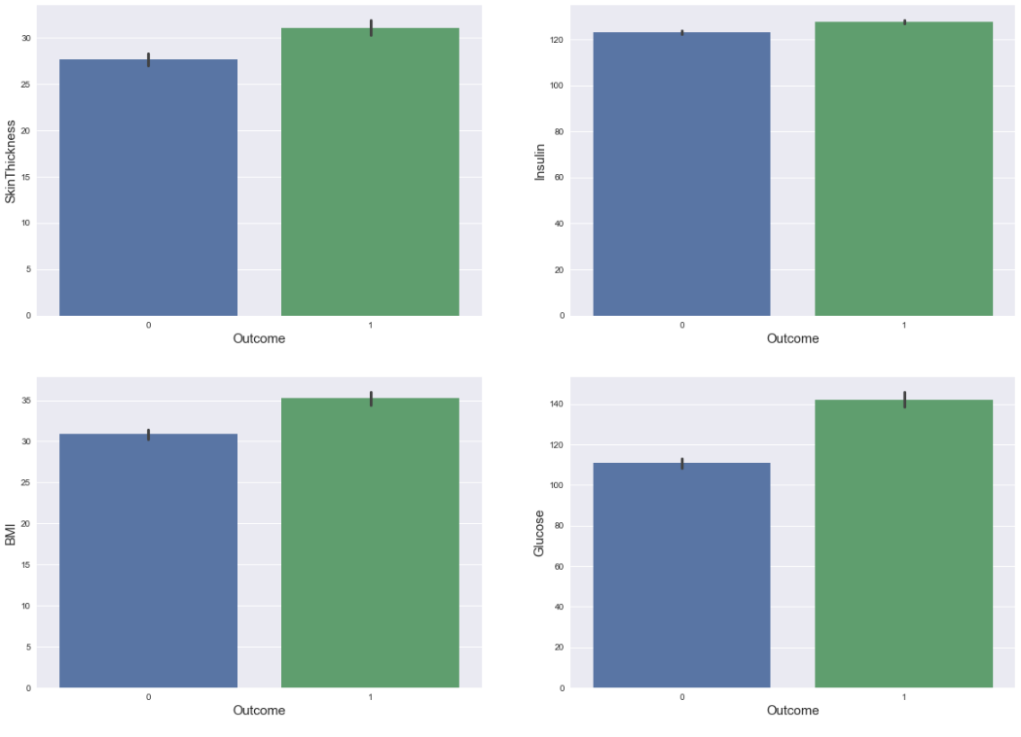
EDA – Variables To Outcome
All variables with higher readings are leaning to a positive outcome
Notes:
Final piece of the data; exploratory analysis would be showing how each variable for each patient with respect to the outcome is shown.
As we can see in the bar chart, the higher the readings are in every variable the outcome would be positive.

Slide 22
Modeling
Notes:
Now we can go through the modelling process and results. In the next few slides, we will go over the steps of the process and what models were applied to the data set. Then I will show a sample of all the models and how the outputs are showing to follow the final step which is interpreting the results.

Slide 23
Model Application
Model Steps
Models Applied
Splitting the data 80% Training 20% Testing
Fitting the model on training set
Predicting the model
Running a Confusion Matrix
Running ROC
Running Classification Report
Appending results
Logistic Regression on all data
Random Forest on all data
Decision Tree on all data
Logistic Regression on high correlated data only
Random Forest on high correlated data only
Decision Tree on high correlated data only
Notes:
Model steps:
Splitting the data 80% training and 20% testing.
Fitting the model on the training set
predicting the model
running a confusion matrix for accuracy
running ROC determine what the AUC area under the curve is.
running the classification report for the F1 score
and then appending the results for each model into a table so that we can compare the results.
Models applied:
The models that were applied where: logistic regression, all the data, all the variables. random forest: all the data. Decision tree: all the data. Logistic regression: on the highly correlated data. Random Forest: on the highly correlated data. Decision tree: on the highly correlated data.

Slide 24
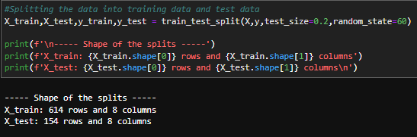
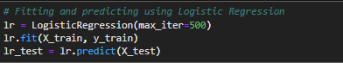
Model Application – Sample
Step One
Step two & Step three
Notes:
Here we can see the sample and we're going to go each step, just show how the code looks like.
step one would be splitting the data into the training and testing sets.
we can see 614 rows with 8 columns in the training set
And 154 rows for the testing set.
Step two and three are pretty much following each other and we can see the logistic regression model. fitting into the training data set and then predicting it into the test set.

Slide 25
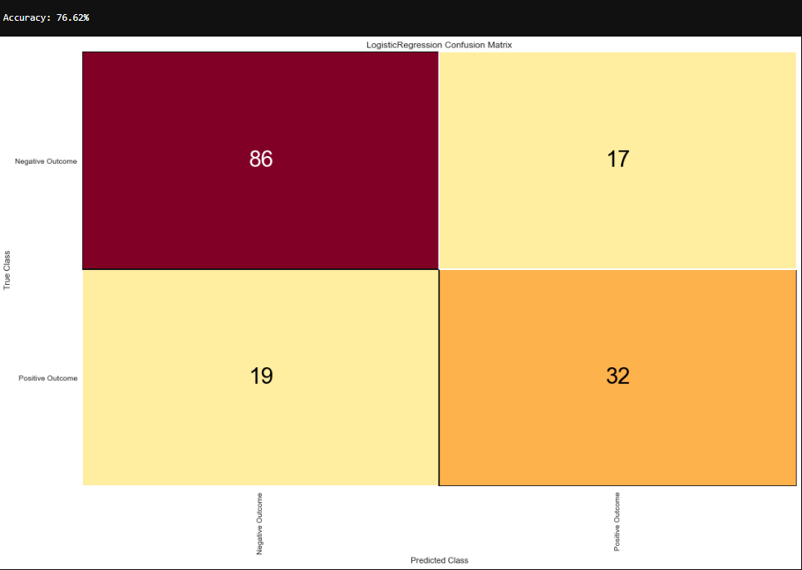
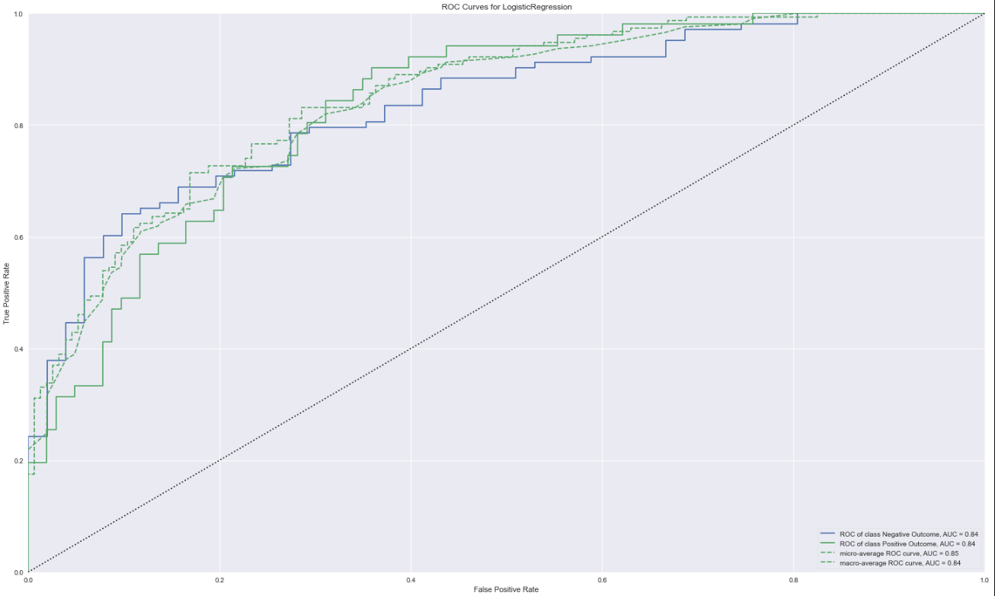
Model Application – Sample (Continued)
Step four
Step five
Notes:
Step 4 would be the confusion matrix. We can see that the model scored a 75.62% accuracy with an AUC score of 84 in step 5.

Slide 26
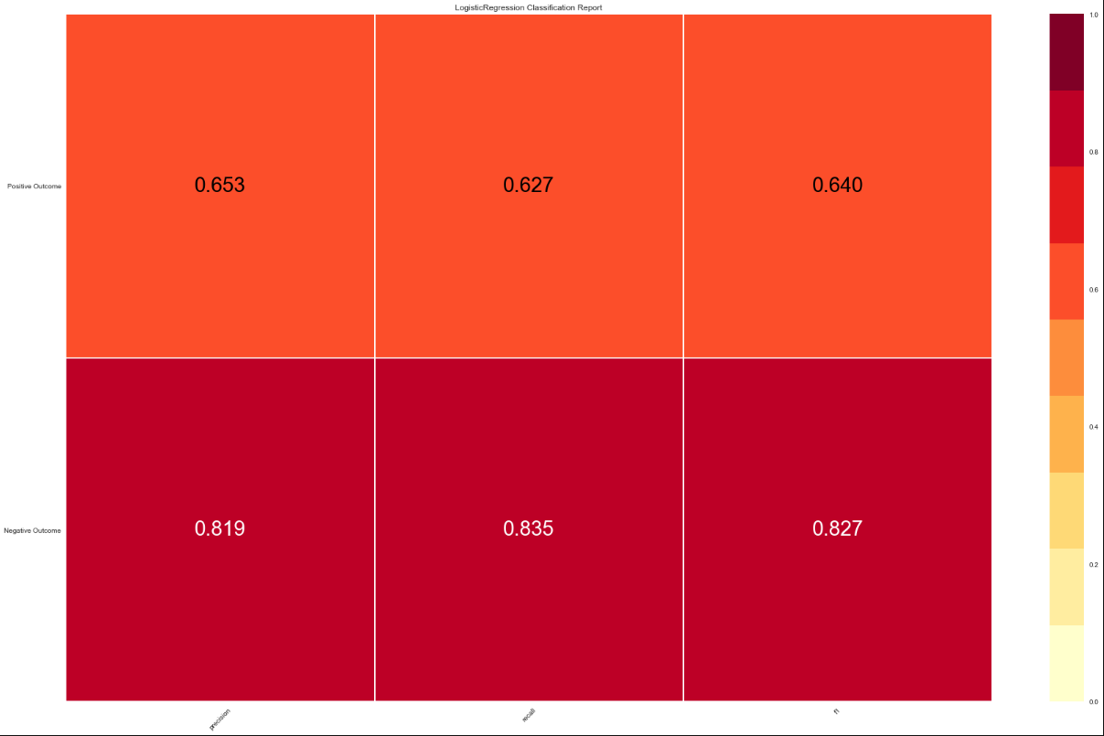
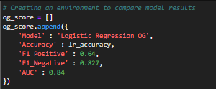
Model Application – Sample (Continued)
Step six
Step seven
Notes:
Step six is mainly focusing on the F1 score. We got an F1 score for the positive outcome of .64 and negative outcome of .827. this is for the logistic regression, all the data again.
Step 7 would be appending the results into the environment where we’re going to interpret our results.

Slide 27
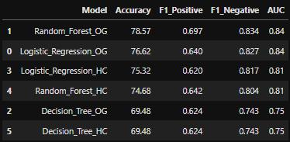
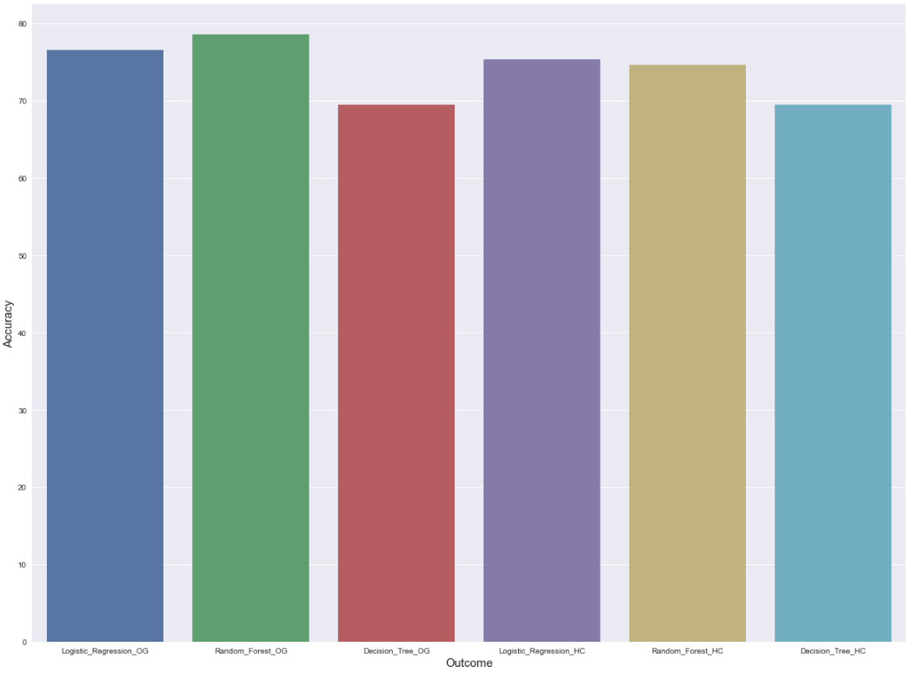
Model Results
Table
Chart
Notes:
As we can see the random forest for all the data scored the highest of 78.57.
Following would be the logistic regression on all the data is 76.62.
What I interpret doing the high correlated exercise resulted in nothing because the model accuracy dropped. So, the other factors were important to improve the models accuracy and therefore, random forests and logistic regression comes in the first and second places.
I would recommend using either. The difference of only about 2%.
And if we look at the chart above, you can give a bit better visualisation on how each model performed.

Slide 28
Thank you!
Notes:
Thank you for your time. I believe the model’s accuracy could be increased if more variables are available. In addition, since there was a pregnancy column, the assumption would be that all the patients are females. To give a better outcome result, indicating gender could help the model perform better.

